Slide 1

NHITM
Enjo
Parking Assistance
Sana Girish, Jeet Ghor, Om Ghag
Computer Engineering – Sem III
August 2023

Slide 2


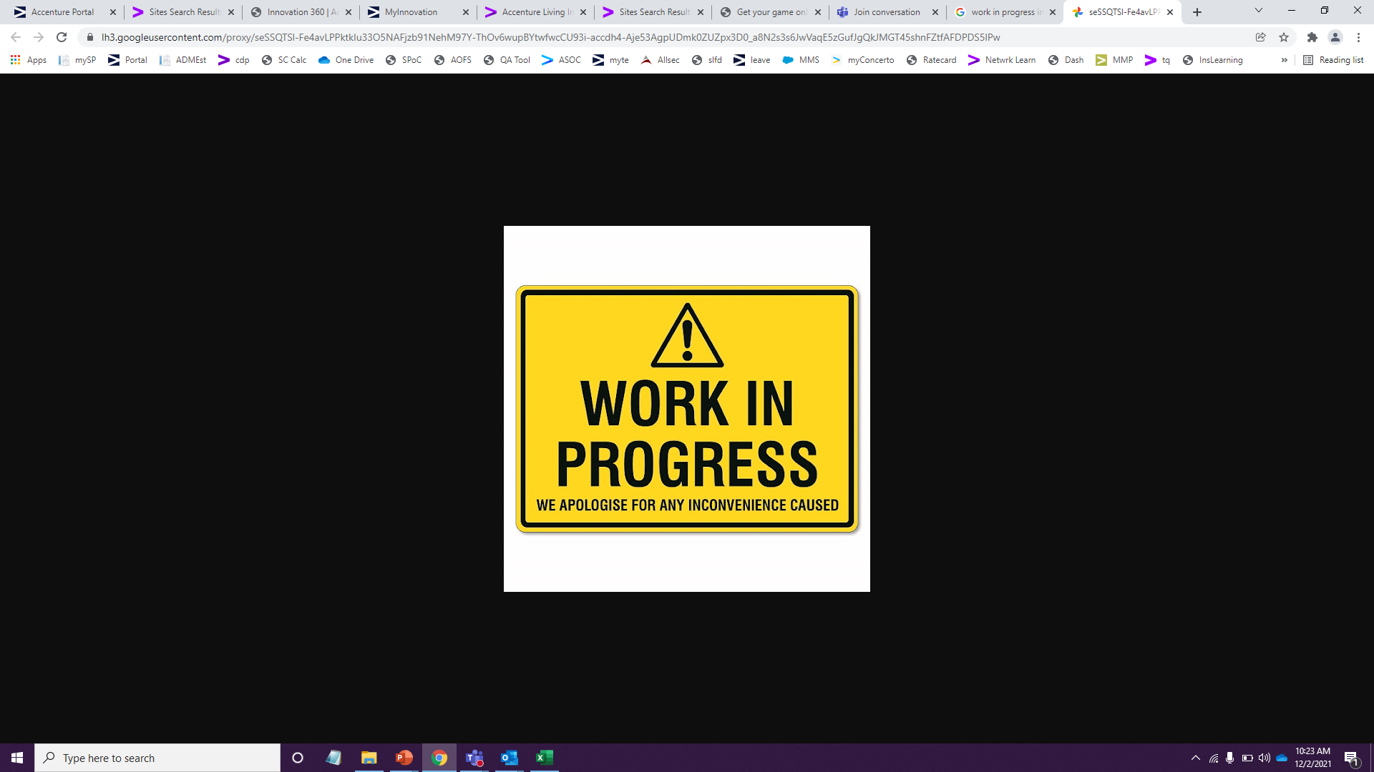
Problem statement
Issues of the common man related to find parking space in cities
We know - You faced similar issues and wanted to act
We all want to contribute to the community in our own wonderful way and wished there was an easy way to do so
Citizens spend a lot of time to find parking space in cities

Slide 3
Solution
How does the tool help?
A GPS tracking system that assists the driver to easily finding a parking space. The tool will provide the real-time data and the insights of parking car lots. on-street and off-street parking data. This app detects current position of User and its address which allows user to add a Parking Space. The idea is to crowd Source Parking spaces to remove problem of spaces in crowded cities.
A standard measurement of the vehicle type will be hardcoded in the system
    Bike
    Three wheeler
    Car
The user must input one of 5 options into the APP
The tool using the GPS tracker will track the current position of the vehicle and will scan the nearby location to identify the spots based on the input parameters.
The APP will also scan if there is any ‘No parking’ , ‘Work In Progress’ sign boards and will notify the user

Slide 4
Technology Stack
System Details (required installation):
OS: Windows 10 or 8
Java: Version 11 or 8
Software Used:
Android Studio . Version: Giraffe 2022.3.1
Android Studio:
Project: FindMeParking
Language: Java. Version: 11
Testing on Virtual Phone in Android Studio
  Device: Pixel
  OS: Android 13.0 x86_64
App Front End:
Dropdown Menu to select Vehicle type
Button to find parking places
Fragment/Section to show map
Route to selected place
Login Menu
App Backend:
Java development
Integration with Google APIs
Firebase Realtime Database
  Version: 20.2.2
External APIs Used:
Google Maps: to display Map
Google Places API: to get/view Parking places in Map
Google APIs:
This requires a project to be created in Google Cloud
For the project, we enable Google Maps and Places API
Notes:
Version used : What is the version of Android Studio Giraffe?
OS: What is installed on Windows 10, What about Android OS? Software will be installed on Windows 10 and App will be installed on Android?
Integration – Using APIs, Google Cloud , ??? . Any version?
Google Pixel – A virtual phone is available inside the software, testing using which version of Android operating system?
How is the data storage done? – Firebase which version ??
Front end - what all comes in front end?
Back end – what all comes in back end ?
Security- What security layer is used integrating with external systems?
In the Minimum viable product(MVP) , there won’t be user login credentials(login id, password), ‘No Parking’ and ‘Work in Progress’ sign boards will not be scanned. Please confirm

Slide 5
Functionalities
Primary App Functionalities
Fetch user’s current location
Get Vehicle Type input from user
Show available parking places to the user
Show the route to the available parking space
Add-On Functionalities
Input latitudes and longitudes values from the user
Notes:
Version used : What is the version of Android Studio Giraffe?
OS: What is installed on Windows 10, What about Android OS? Software will be installed on Windows 10 and App will be installed on Android?
Integration – Using APIs, Google Cloud , ??? . Any version?
Google Pixel – A virtual phone is available inside the software, testing using which version of Android operating system?
How is the data storage done? – Firebase which version ??
Front end - what all comes in front end?
Back end – what all comes in back end ?
Security- What security layer is used integrating with external systems?
In the Minimum viable product(MVP) , there won’t be user login credentials(login id, password), ‘No Parking’ and ‘Work in Progress’ sign boards will not be scanned. Please confirm

Slide 6
Advantages
Enhanced Convenience and Efficiency
Reducing fuel consumption
Time and Cost Savings
Real-time Availability and Updates
Navigation and Directions
Integration with Other Services
Parking Availability Notifications

Slide 7





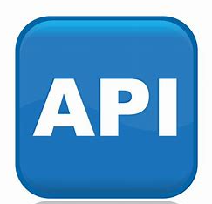




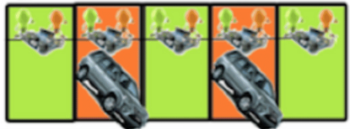
Logical Architecture
SUV
Hatchback
Parking Assistance APP
Sedan
User
Google Maps
2-wheeler
3-wheeler
Free Spot
Occupied Spot
Parking Lot

Slide 8

Detailed Technical Architecture
Android App User Interface
Handles user interactions, such as selecting a parking spot, registering an empty parking spot, and initiating navigation
User
Uses
Filtered Parking Spots Data
MainActivity
The main activity of the app that manages the user interface and user interactions
Uses
Filtered Parking Spots Data sent to user by LiveData
ViewModel & LiveData
Represents the ViewModel component from the Android Architecture Components. It holds UI-related data and provides it to the UI components. LiveData is used to observe changes in data and update the UI
Requests Location Services to retrieve User Location
Requests to retrieve nearby Parking Spots
Location Services
Android's Location Provider API to retrieve the user's current location
filtered parking spots data
Repository
Acts as a single source of truth for data management. It abstracts the data sources (local database, network) from the ViewModel and provides clean data to the UI
Requests to retrieve nearby Parking Spots
Network Services
Acts as a single source of truth for data management. It abstracts the data sources (local database, network) from the ViewModel and provides clean data to the UI
nearby parking spots data
communicates to fetch nearby parking spot data
Google Places API

Slide 9
Detailed Technical Architecture
The user interacts with the app's UI (MainActivity).
The ViewModel requests the user's current location using FusedLocation.
The ViewModel sends a request to the Repository to find nearby parking spots.
The Repository communicates with Network Services to fetch nearby parking spot data.
The Network Services communicate with the Google Places API to fetch place data.
The ViewModel receives the place data from the Repository and filters it for parking spots.
The ViewModel provides this filtered data to the UI components using LiveData.
The UI displays the parking spots on the map and handles user interactions.
If the user selects a parking spot, the ViewModel calculates and provides navigation data.
The UI displays navigation routes using the Navigation Functionality.

Slide 10
Glossary
Features | Description
API | An application programming interface is a way for two or more computer programs to communicate with each other.
Android Emulator | The Android Emulator simulates Android devices on your computer so that you can test your application on a variety of devices and Android API levels without needing to have each physical device. The emulator offers these advantages: Flexibility: In addition to being able to simulate a variety of devices and Android API levels, the emulator comes with predefined configurations for various Android phone, tablet, Wear OS, and Android TV devices. High fidelity: The emulator provides almost all the capabilities of a real Android device. You can simulate incoming phone calls and text messages, specify the location of the device, simulate different network speeds, simulate rotation and other hardware sensors, access the Google Play Store, and much more. Speed: Testing your app on the emulator is in some ways faster and easier than doing so on a physical device. For example, you can transfer data faster to the emulator than to a device connected over USB. In most cases, the emulator is the best option for your testing needs. This page covers the core emulator functionalities and how to get started with it. Alternatively, you can deploy your app to a physical device.
Android App User Interface | In an Android application, the user interface is built using View and ViewGroup objects.

